Slide 1
Telecom Churned Customers Prediction using ML techniques
Team name: AI-Teck, Group(3)
AI Course
Notes:
Note:

Slide 2

UNIT 1. 1.1. Intro
What is Churn Customer?
Churn Customer means customer who leave or stop using the service or product of the company.
It means no more revenue from those customers.
Do you imagine that churn customer could cost more than 25 times to gain new customers.
Churner Customer
Notes:
Note:
So, what does churn customer mean? It means customer who leaves the company or stop using their services.
Does it really impact on the company business and growth? Absolutely, churn customer could cost the company more than 25 times to gain new customers.

Slide 3
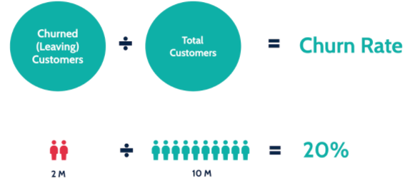
UNIT 1. 1.2. Intro
What is the objective?
Develop a churn prediction model.
So the companies can develop proper strategy to re-engage them before they leave and cause losing customers and decrease the revenue.
Notes:
Note:
So, our objective is to develop a churn prediction model to avoid losing customers and trying to increase revenue. In this formula, we can calculate the churn rate by dividing the churn customers over the total customers.

Slide 4
UNIT 2. Data 2.1. Abstract
Data Description
The Telco customer churn data contains information about a Telcom company that provided home phone and Internet services customers in California in Q3. The data indicates whether the customer churned or not.
Data Shape
7033 Rows, 33 columns
Data Source: IBM Community
https://community.ibm.com/accelerators/?context=analytics&query=telco%20churn&type=Data&product=Cognos%20Analytics
Notes:
Note:
Some examples of random experiments are:
+Flipping a coin.
+Rolling dices.
You will start with these simple examples and build a basis of probability.

Slide 5
UNIT 2. Data 2.2. Data Features
Data Features
Categorical Features
True, False
Location Features
Gender
Senior Citizen
Partner
Dependents
Phone Service
Multiple Line
Internet Service
Online Security
Online Backup
Device Protection
Tech Support
Streaming TV
Streaming Movies
Contract
Paperless Billing
Payment Method
Churn Value
Numeric Features
Tenure Months
Monthly Charges
Total Charges
Notes:
Note:
Some examples of random experiments are:
+Flipping a coin.
+Rolling dices.
You will start with these simple examples and build a basis of probability.

Slide 6
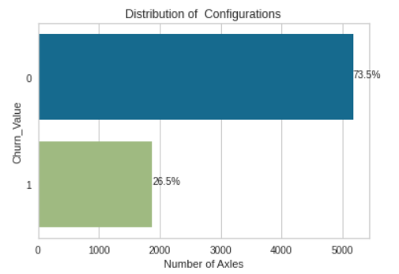
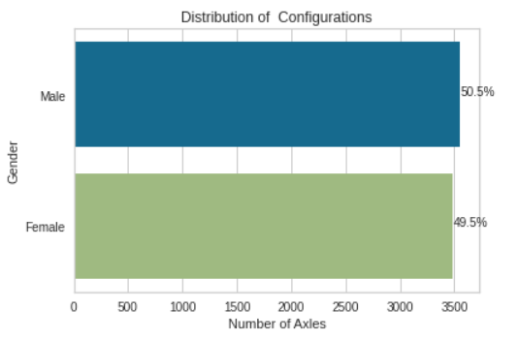
UNIT 2. Data 2.3. EDA
EDA
Churn Value
Gender
Notes:
Note:
Some examples of random experiments are:
+Flipping a coin.
+Rolling dices.
You will start with these simple examples and build a basis of probability.

Slide 7
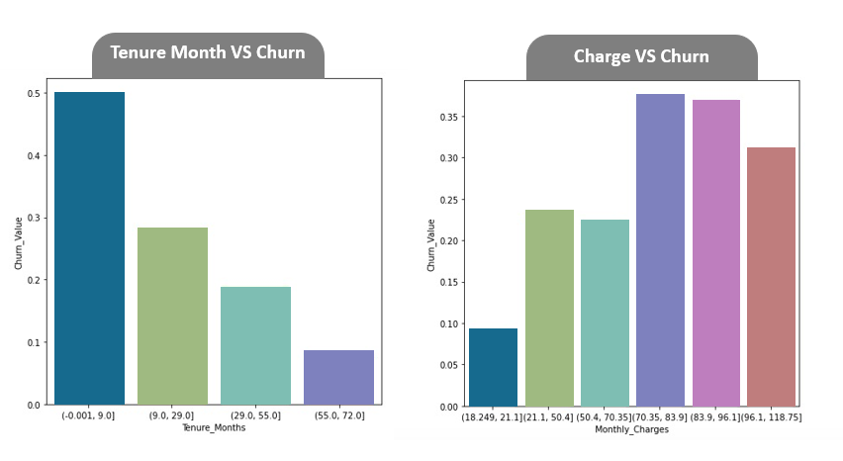
UNIT 2. Data 2.3. EDA
EDA
Notes:
Note:
Some examples of random experiments are:
+Flipping a coin.
+Rolling dices.
You will start with these simple examples and build a basis of probability.

Slide 8

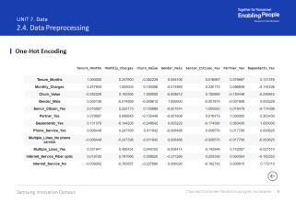
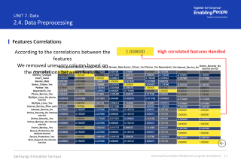
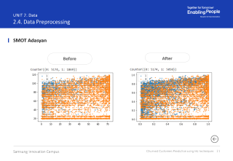
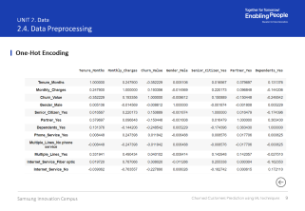
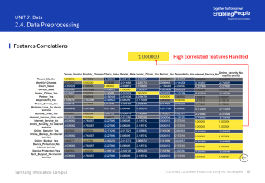
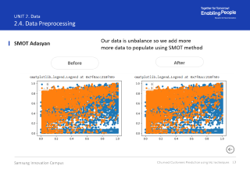
UNIT 2. Data 2.4. Data Preprocessing
Data Preprocessing
1
One-Hot Encoding
2
Features Correlations
3
SMOT Adasyan
Notes:
Note:
Some examples of random experiments are:
+Flipping a coin.
+Rolling dices.
You will start with these simple examples and build a basis of probability.

Slide 9
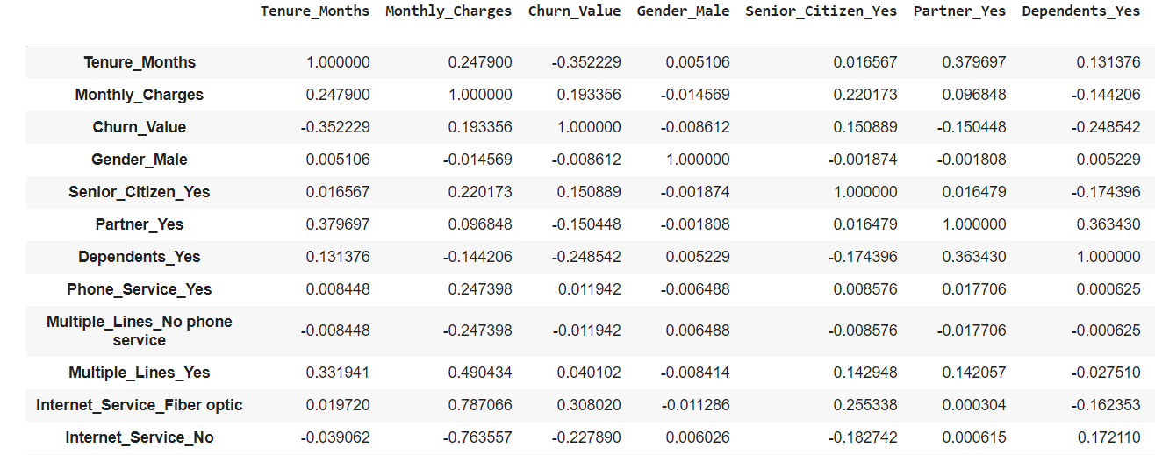

UNIT 2. Data 2.4. Data Preprocessing
One-Hot Encoding
Notes:
Note:
Some examples of random experiments are:
+Flipping a coin.
+Rolling dices.
You will start with these simple examples and build a basis of probability.

Slide 10
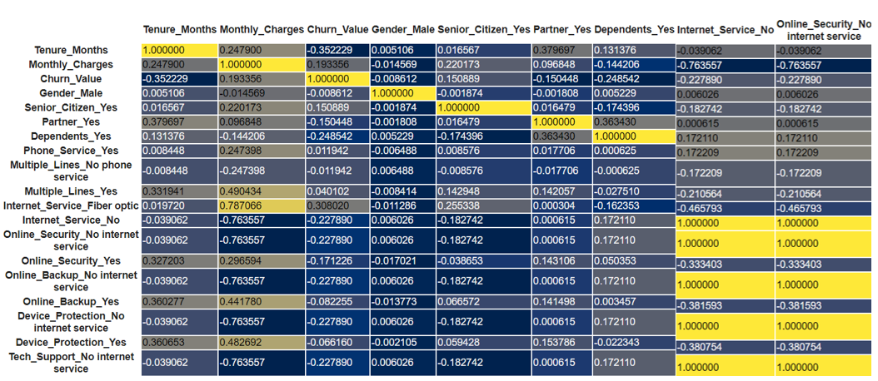
UNIT 2. Data 2.4. Data Preprocessing
Features Correlations
1.000000
High correlated features Handled
Notes:
Note:
Some examples of random experiments are:
+Flipping a coin.
+Rolling dices.
You will start with these simple examples and build a basis of probability.

Slide 11
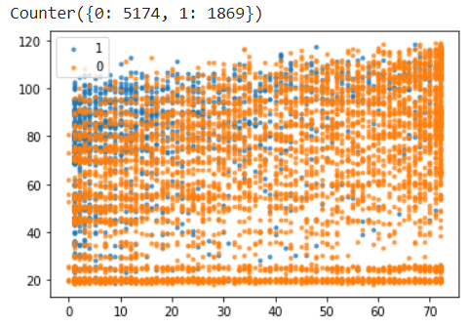
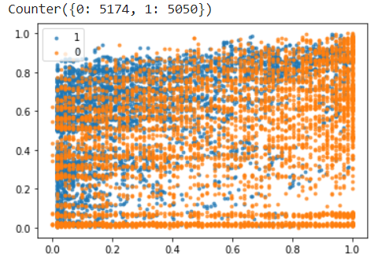
UNIT 2. Data 2.4. Data Preprocessing
SMOT Adasyan
Before
After
Notes:
Note:
Some examples of random experiments are:
+Flipping a coin.
+Rolling dices.
You will start with these simple examples and build a basis of probability.

Slide 12
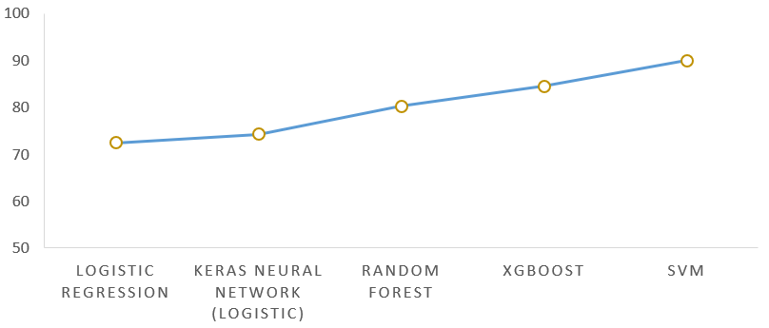





UNIT 3. ML Algorithms 3.1. Algorithms
88.9%
85.6%
Accuracy (%)
80.2%
72.2%
74.4%
SVM
Models
Notes:
Note:
Some examples of random experiments are:
+Flipping a coin.
+Rolling dices.
You will start with these simple examples and build a basis of probability.

Slide 13
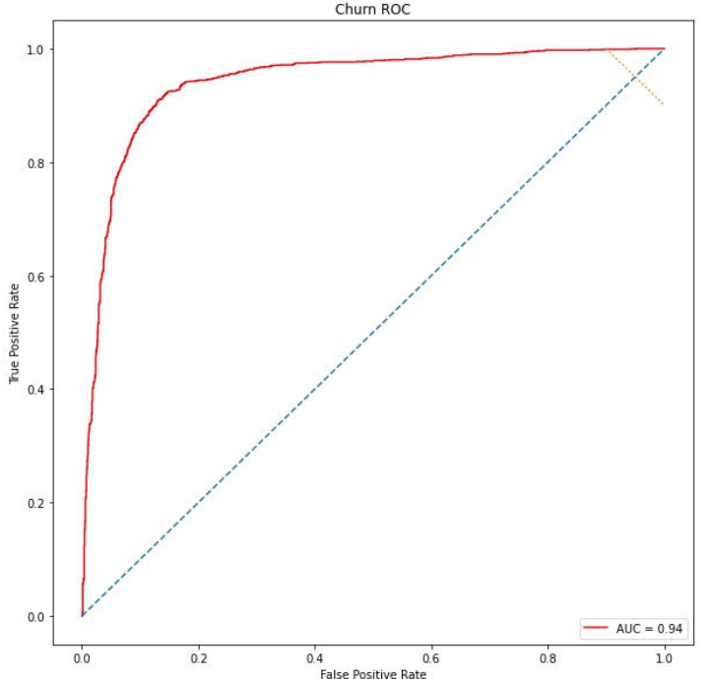
UNIT 3. ML Algorithms 3.2. Evaluation
ML Methods and Algorithms
Evaluation the performance of the models:
AUC
F1-Score
Notes:
Note:
Some examples of random experiments are:
+Flipping a coin.
+Rolling dices.
You will start with these simple examples and build a basis of probability.

Slide 14
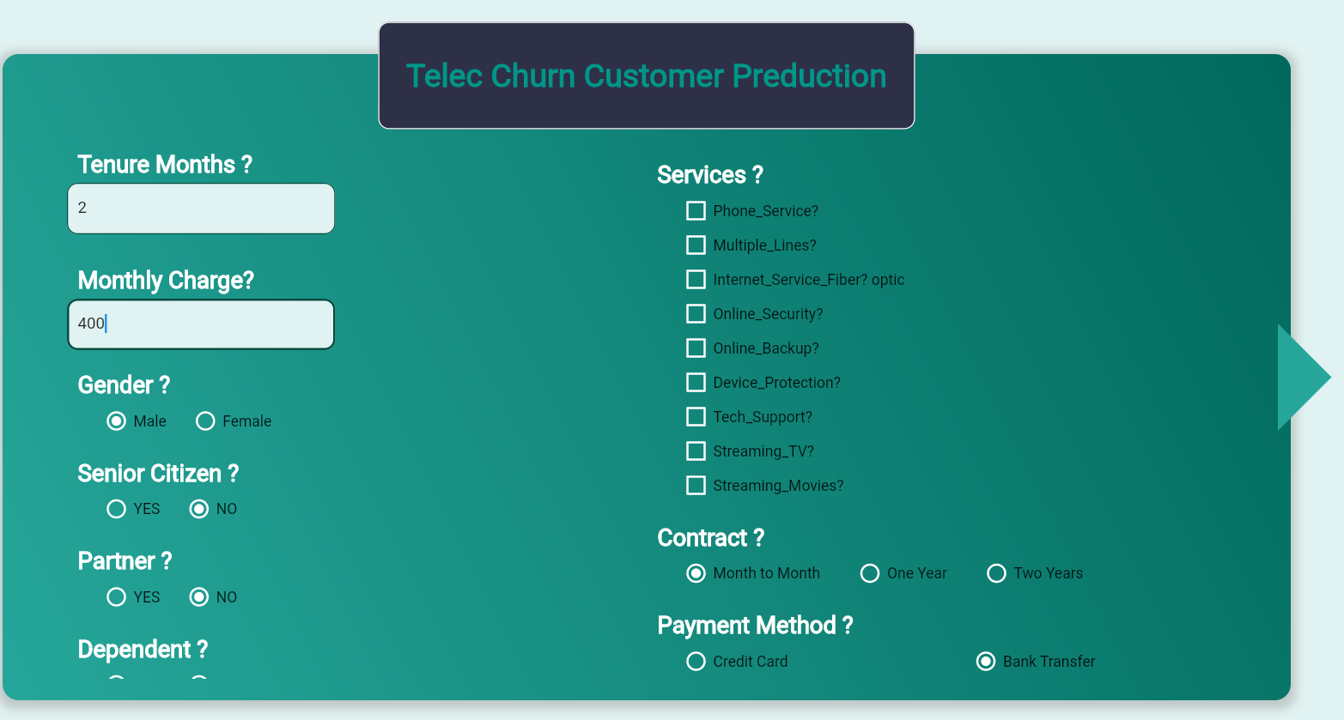
UNIT 4. Deployment 4.1. Interactive Prediction
Demo
Please Click
Demo
Notes:
Note:
Some examples of random experiments are:
+Flipping a coin.
+Rolling dices.
You will start with these simple examples and build a basis of probability.

Slide 15
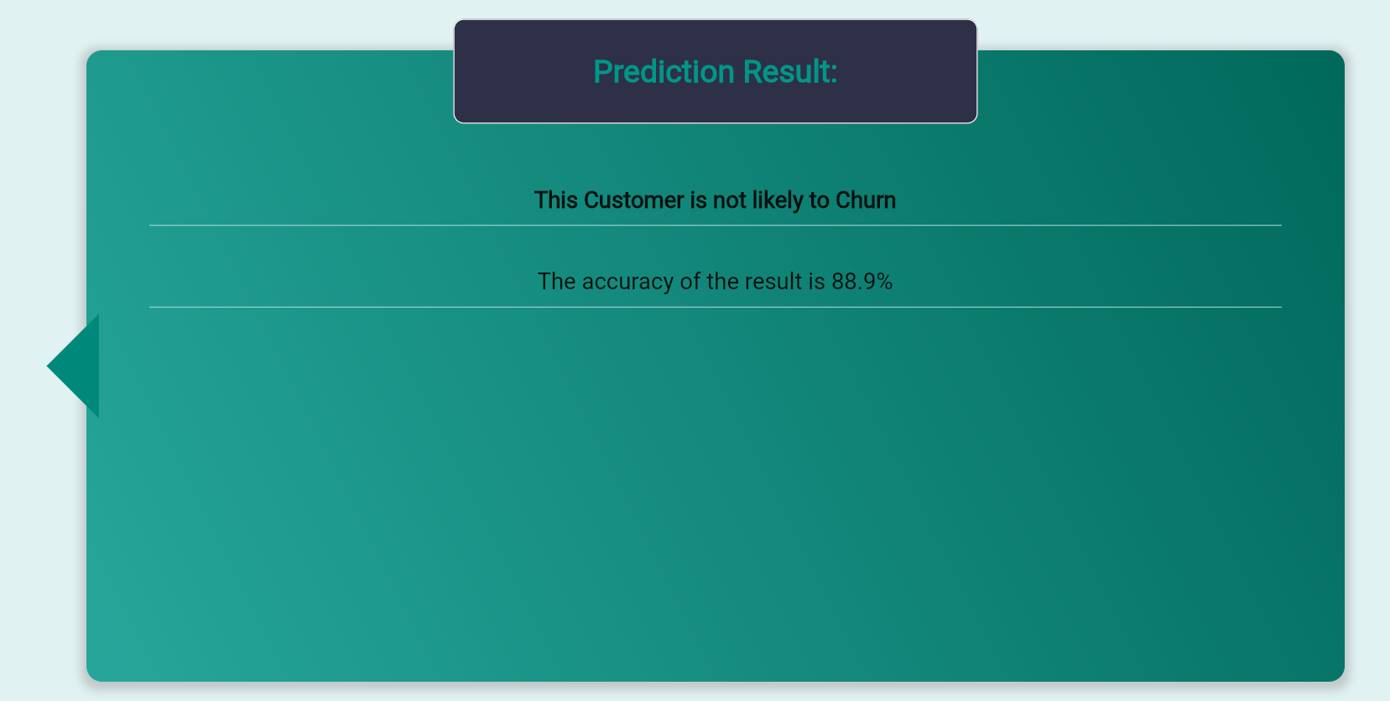
UNIT 4. Deployment 4.1. Interactive Prediction
Demo
Please Click
Demo
Notes:
Note:
Some examples of random experiments are:
+Flipping a coin.
+Rolling dices.
You will start with these simple examples and build a basis of probability.

